Slide 1

SECURITY ARCHITECTURE
LECTURE I (Application Isolation)
Speaker: Dimitrios Valsamaras | @Ch0pin
https://www.linkedin.com/in/valsamaras/

Slide 2
The development of Android started in 2003 by Android, Inc., which was purchased by Google in 2005
The first public release of Android 1.0 occurred with the release of the T-Mobile G1 (aka HTC Dream) in October 2008
The project manager, Ryan Gibson, conceived using a confectionery-themed naming scheme for public releases, starting with Android 1.5 Cupcake. Google announced in August 2019 they were ending the confectionery theming scheme to use numerical ordering for future versions (Android 10 was the first)
In 2017, Google announced that Google Play would begin to require apps to target a recent Android version. Initially the minimum requirement was Android 8, released in the second half of 2017, for which support would be required for new apps by August 2018, and for updates to existing apps by November 2018
In November 2020, Google announced new apps will need to target Android 10 by August 2021 and any updates to existing apps will need to target Android 10 by November 2021
REF: Wikipedia

Slide 3
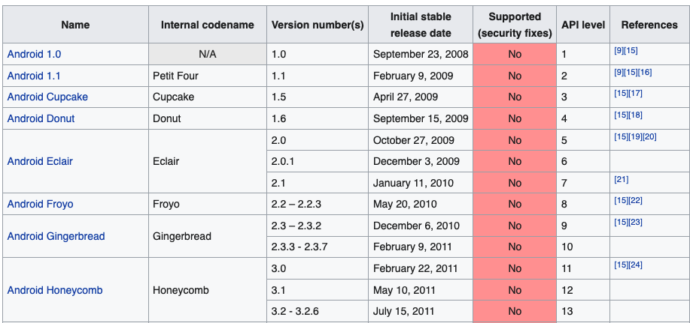
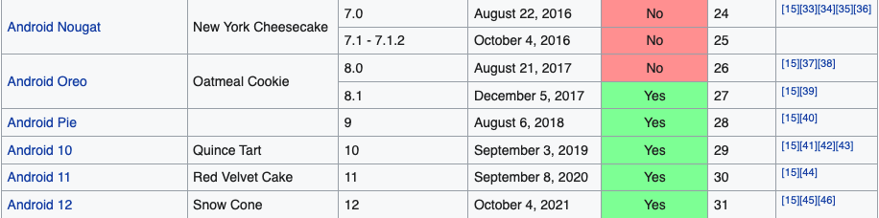

Slide 4
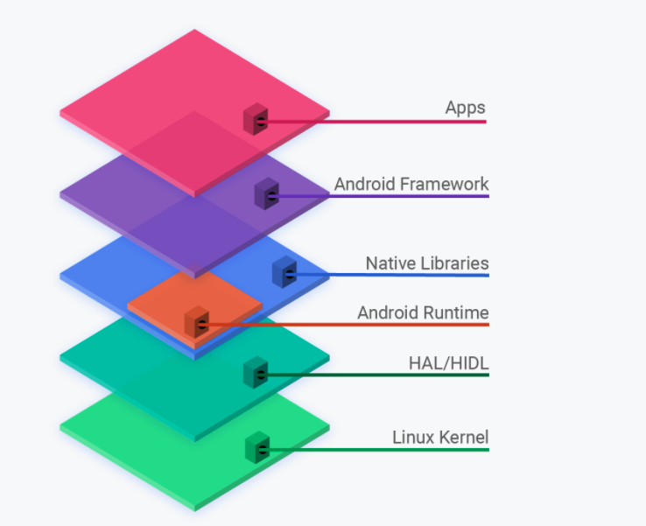
About the Android Open Source Project (AOSP)
Android is an open source operating system for mobile devices and a corresponding open source project led by Google
This site and the Android Open Source Project (AOSP) repository offer the information and source code needed to create custom variants of the Android OS
Android Code Search: https://cs.android.com/

Slide 5

BASICS OF ACCESS CONTROL
BASIC CONCEPTS
ACCESS CONTROL MODELS (DAC / MAC)

Slide 6
BASICS OF ACCESS CONTROL
Resources, Data, Hardware...
Users, Programs e.t.c.
Type of operation, parameters...
SUBJECT
OBJECT
ACCESS REQUEST

Slide 7
ACCESS CONTROL: The process of deciding whether an access request should be granted or not.
Users, Programs e.t.c.
Resources, Data, Hardware...
Reference monitor
SUBJECT
OBJECT
ACCESS REQUEST
ACCESS REQUEST
Access Control Matrix
AC MODEL
Object | Subject | Operation
Program A | File1 | read, write
Program B | Resource1 | read
Policy

Slide 8
ACCESS CONTROL POLICY MODELS
Discretionary Access Control / DAC:
Subjects can delegate access by changing the protection state
Mandatory Access Control / MAC:
Access policy is decided from a central authority

Slide 9
Mandatory Access Control
Subjects and Objects assigned labels
Label of an object/subject corresponds to its protection domain
Label (Domain)
subject
Belongs
Object
Example: John belongs to a Top Security group which has access to Top Secret files

Slide 10
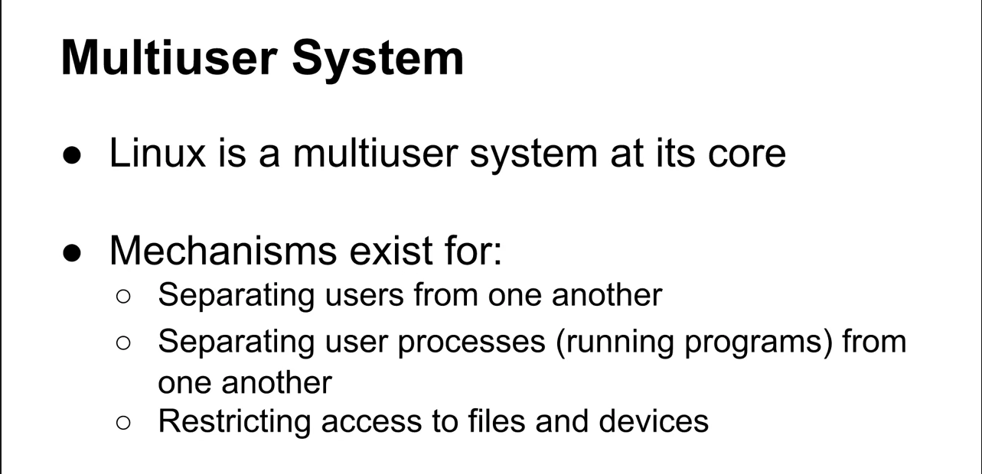
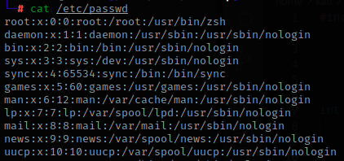
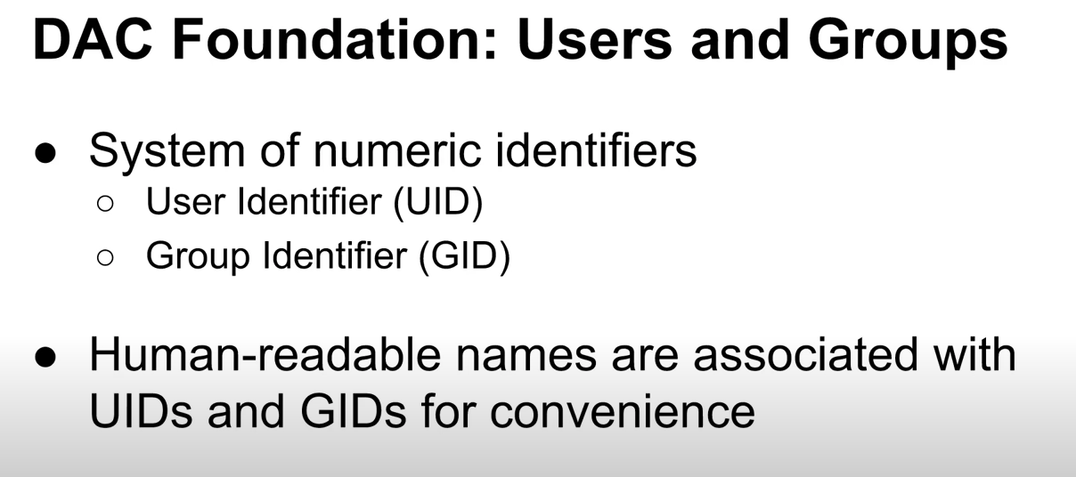

Android Platform Security
Android is a Linux Based Operating system:

Slide 11
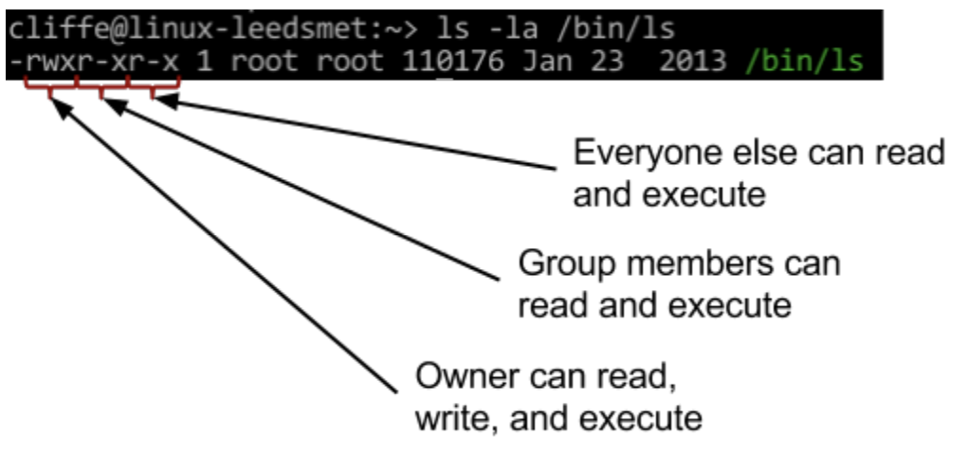
Android Platform Security
Android is a Linux Based Operating system:
Three permission triads
first triad | what the owner can do
second triad | what the group members can do
third triad | what other users can do
Each triad
first character | r: readable
second character | w: writable
third character | x: executable s or t: setuid/setgid or sticky (also executable) S or T: setuid/setgid or sticky (not executable)
Binary Representation:
rwx r w - r - x
111 110 101 765 (dec)

Slide 12
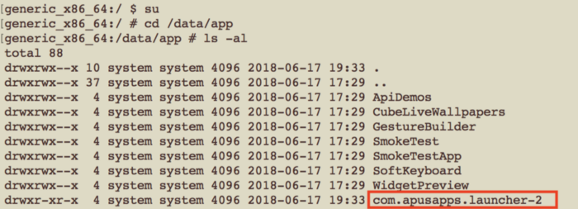
Each application is a unique user ? How an Android App is installed ?
A major difference between Android and Linux is that Android isolates each application from other applications to prevent malicious applications from snooping or crashing other installed application. This approach is known as “Sandboxing”, Android achieves this by considering each application as a different user.
The Package Manager
Copy the APK file and any native libraries within the app to:
/data/app/<package name>-<num>/ (Android 7)

Slide 13
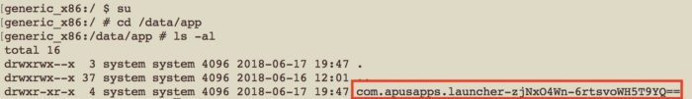
The Package Manager
Copy the APK file and any native libraries within the app to:
/data/app/<package name>-<num>/ (Android 7)
Since Android Oreo, the code has been changed
/data/app/<package name>-<B64 encoded Random Bytes>/ (Android 8)
Figure courtesy of ref

Slide 14
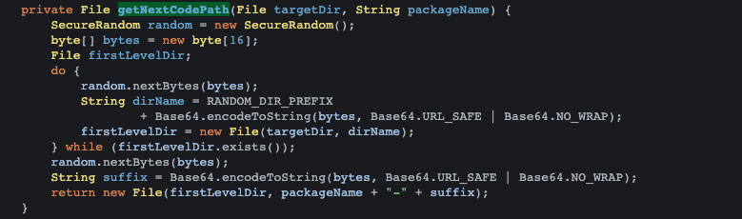
The Package Manager
Copy the APK file and any native libraries within the app to:
/data/app/<package name>-<num>/ (Android 7)
/data/app/<package name>-<B64 encoded Random Bytes>/ (Android 8)
…
…
Review the Code
“~~”
# pm path com.foo.bar //(use the ‘pm’ command to get the installation dir)
package:/data/app/~~RuDNoTK2FUJZm1mWbo9UOA==/com.foo.bar-PamO3LPp0P7bH07lftXrjQ==/base.apk

Slide 15
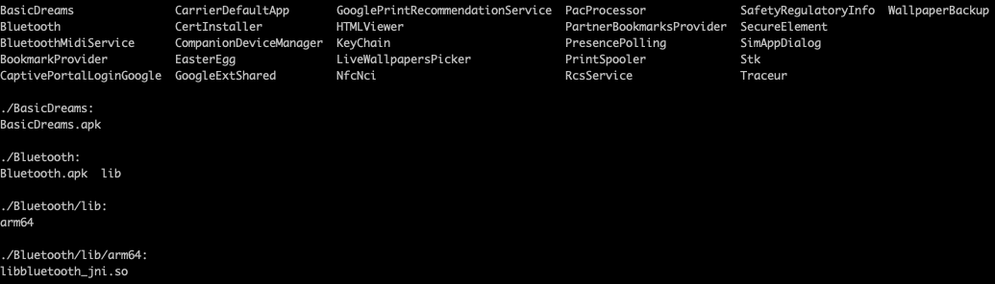
The Package Manager
/system/app directory contains the system applications:
#ls -R /system/app

Slide 16
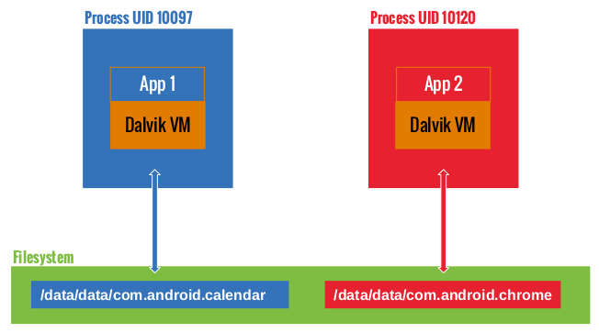
Package manager - Each application is a unique user
For the Android OS each application is a distinct user
When an application is installed, it is assigned with a unique UID and GID
Each application is executed in a dedicated process and is assigned with a dedicated data directory. This directory is set in a way that no other app can access it besides the owner
Figure by: Mobile Security Gitbook

Slide 17
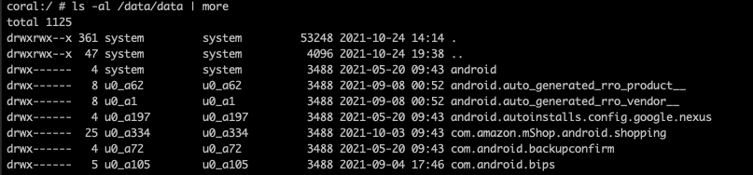
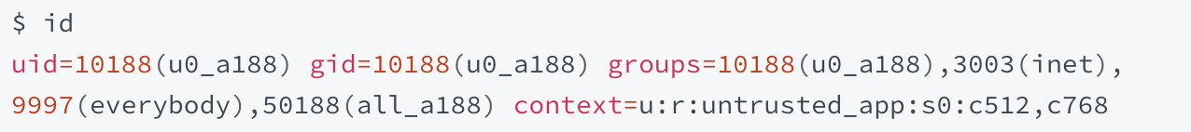
Package manager - Each application is a unique user
Apps are assigned UIDs (or AID) in the range of 10000 and 99999
They receive a user name based on their UID. For example, the app with UID 10188 receives the user name u0_a188
If the permissions an app requested are granted, the corresponding group ID is added to the app's process:

Slide 18
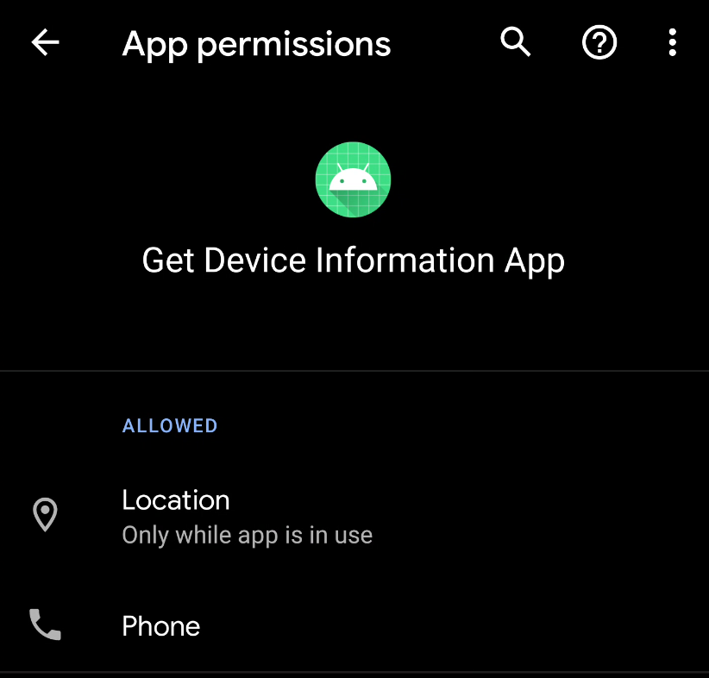
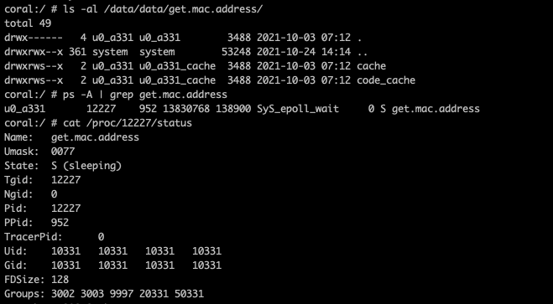
Package manager - Each application is a unique user
package name
app human readable id
process id

Slide 19

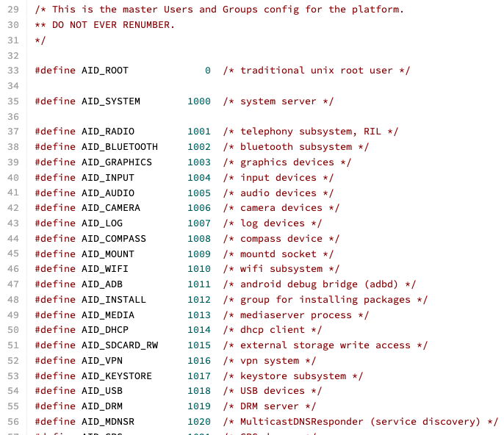
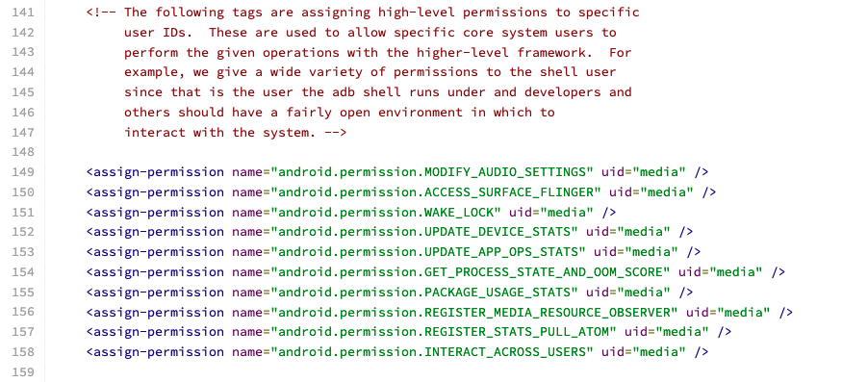
Android Platform Security - Permissions and Groups
#define AID_NET_BT 3002 /* bluetooth: create sco, rfcomm or l2cap sockets */
#define AID_INET 3003 /* can create AF_INET and AF_INET6 sockets */
android_filesystem_config.h
platform.xml

Slide 20
Android Platform Security - Permissions and Groups
Two applications can request the same UID by setting the same value of android:sharedUserId in their AndroidManifest.xml files. This is only possible if both application are going to be signed by the same developer certificate
System apps are using special UIDs to access various components. When building a custom ROM for Android device these apps can be added to the /aosp/device/generic/goldfish directory, while for the app to run with system privileges the android:sharedUserId="android.uid.system" must be added to the manifest file and signed with the platform certificate:
Android.mk
LOCAL_CERTIFICATE := platform
LOCAL_PRIVILEGED_MODULE := true

Slide 21
REFERENCES:
https://valsamaras.medium.com/the-application-sandbox-9abd09a5c6da
http://malzantot.blogspot.com/2015/04/dissecting-android-permissions.html
https://medium.com/@quaful/the-changes-of-apk-install-location-since-android-oreo-e646d1b53c4d
https://cs.android.com/android/platform/superproject/+/master:
https://devarea.com/aosp-creating-a-system-application/#.YXZUPdbMKdY

